Slide 1
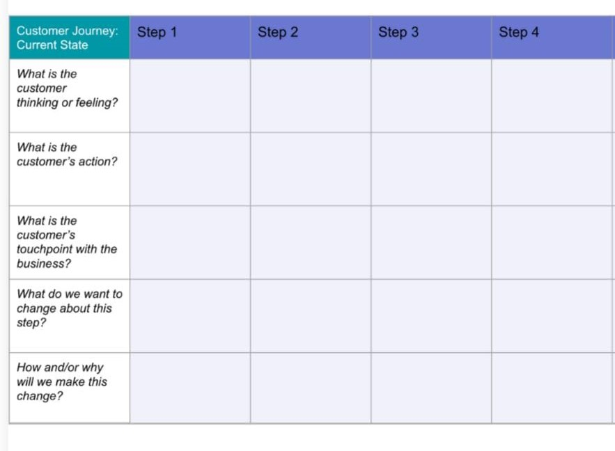
Not getting
Conventional reading application.
Not getting relevant news.
They Need to subscribe to get news.
May be this isn’t the best.
Looking for the
Best News application.
They will search proper information in news papers.
News from Social media news posts and news television channels.
Confused by their choice.
By Like ,Comments, Save and Share the news.
By customer regularly using this application.
By providing proper news according to their choice.
By increasing the count visitors.
Customer no need to subscribe to get news in our application.
Customer will have personalization features in our application.
Customer will not get unnecessary ads and also they will have basic life support.
By providing quick short news
In our application.
Since we provide short crisp news user time is saved.
They can manage their profile and also they have search and filter option for getting news.
By knowing uninterested topic or content.
User using the app regularly will create awareness of their surrounding.

